Slide 1
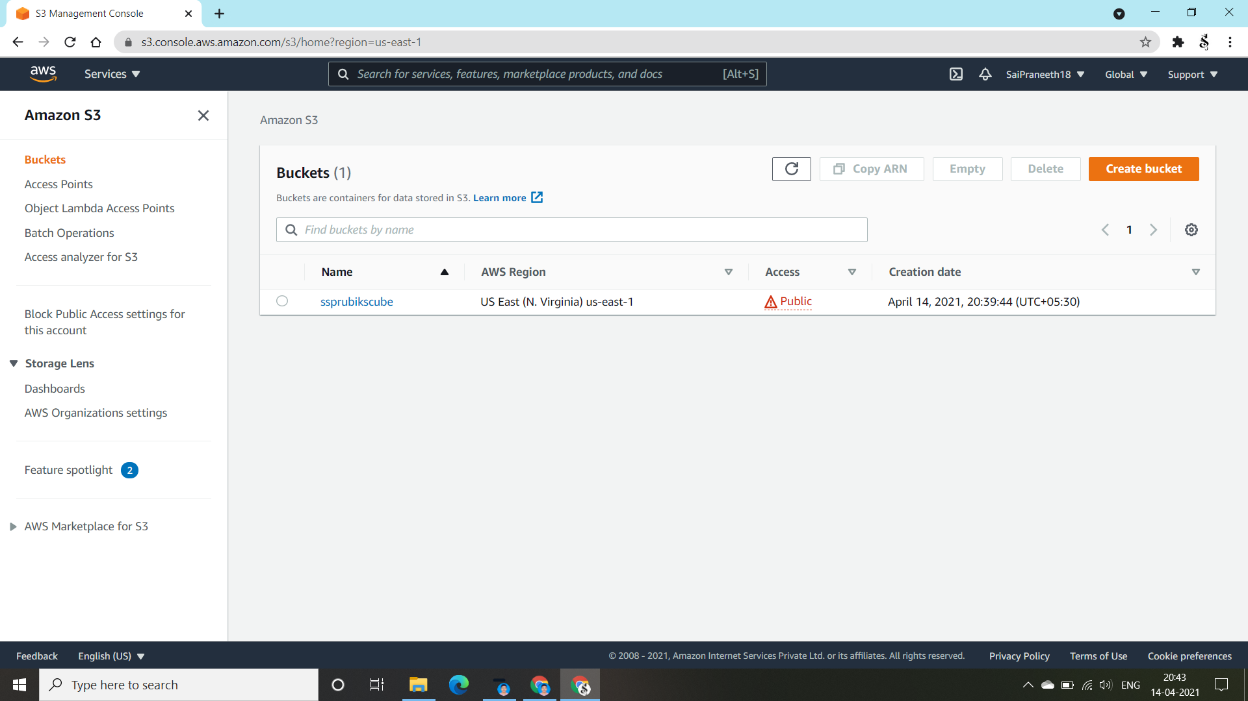
Our Project is to launch a “Rubik's Cube” gaming website using “APACHE” Web Launcher using “AWS”. So, Go to aws.amazon.com and sign in to the console. Open the s3 Management Console. First we need to create an “s3 bucket” of a name of our own but here we are going to create a Rubik's cube gaming website to I named it as “ssprubikscube”. I made the bucket to public access using “ACL” permissions by opening the bucket and the region would be by default. Therefore Our first step to create an s3 bucket is done.

Slide 2
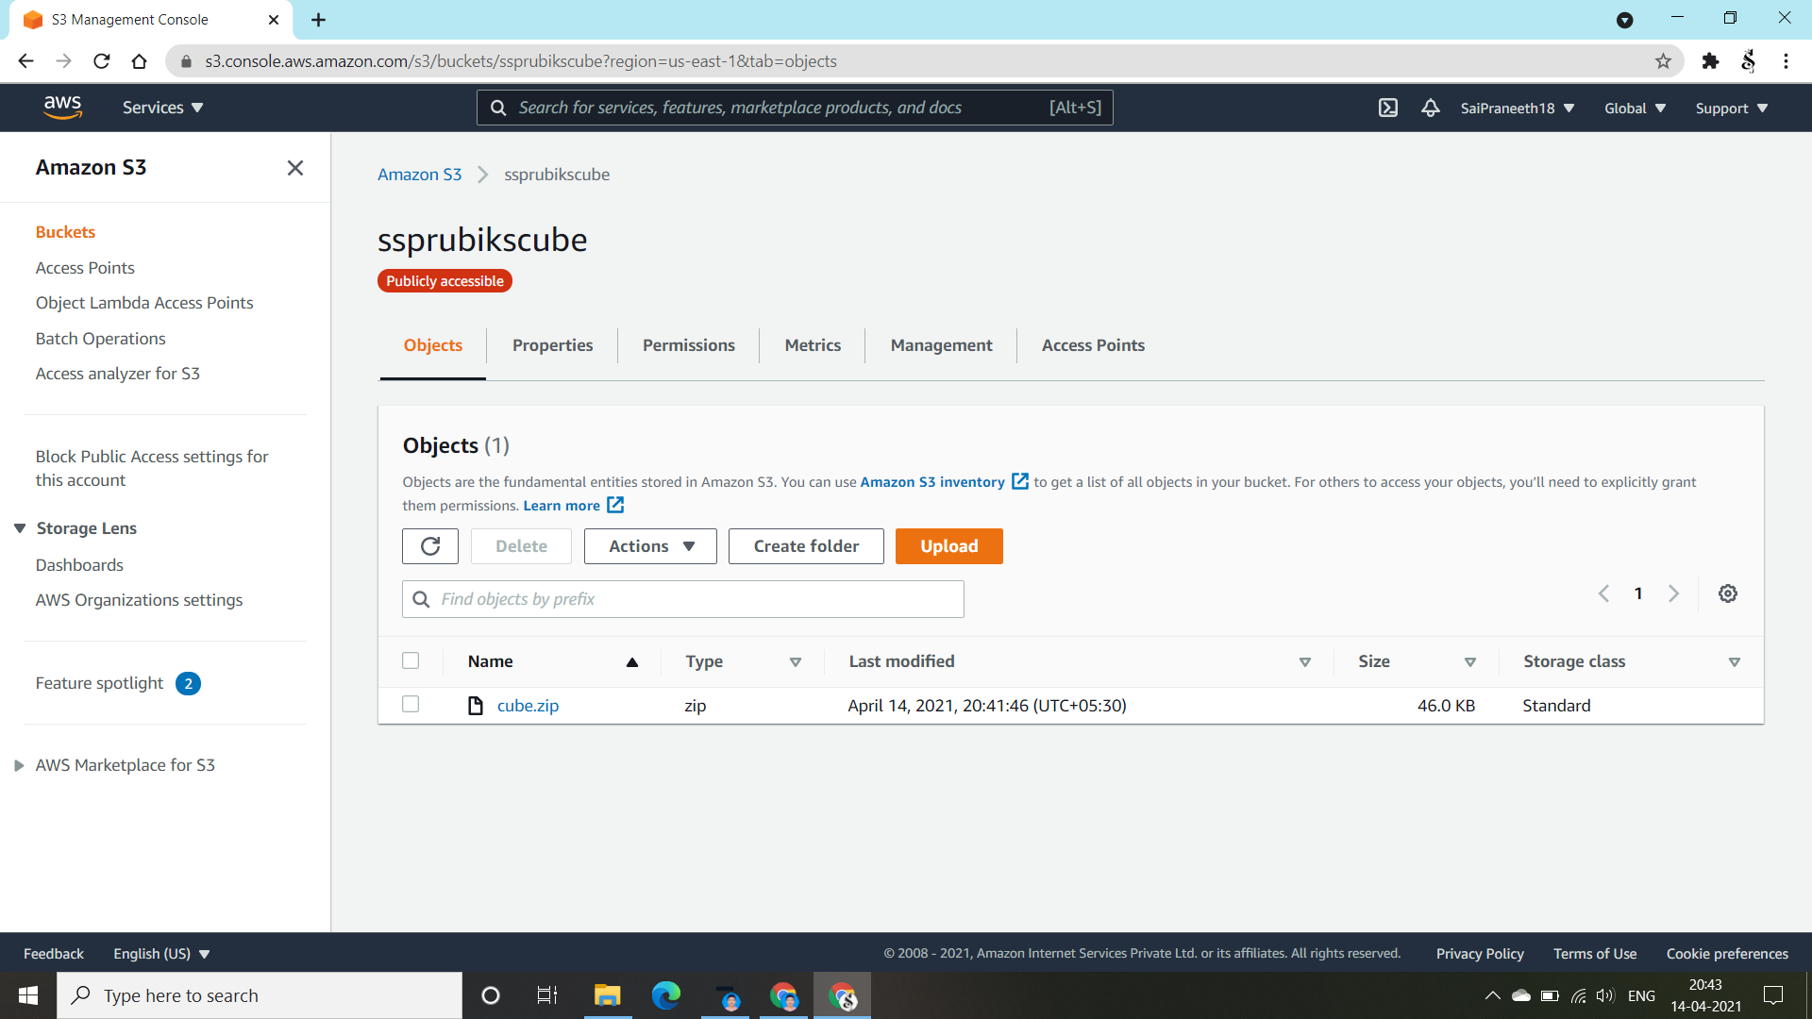
After creation of the s3 bucket, check the permissions whether they are made open to public or not. We need to upload cube.zip file in the objects portal of the bucket. I have used the google drive link provided by my mentor and downloaded the zip file but not going to extract it. Now, select to upload files and upload the cube.zip file into it and check the authorization and make it into public access. Therefore, cube.zip is uploaded successfully as shown above.

Slide 3
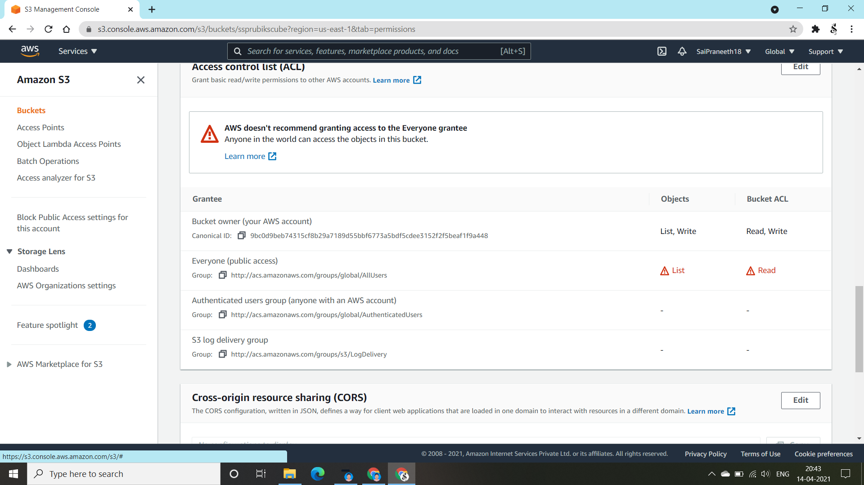
Here we are going to make the permissions of the s3 bucket using “ACL(Access Control List)” to public access.

Slide 4
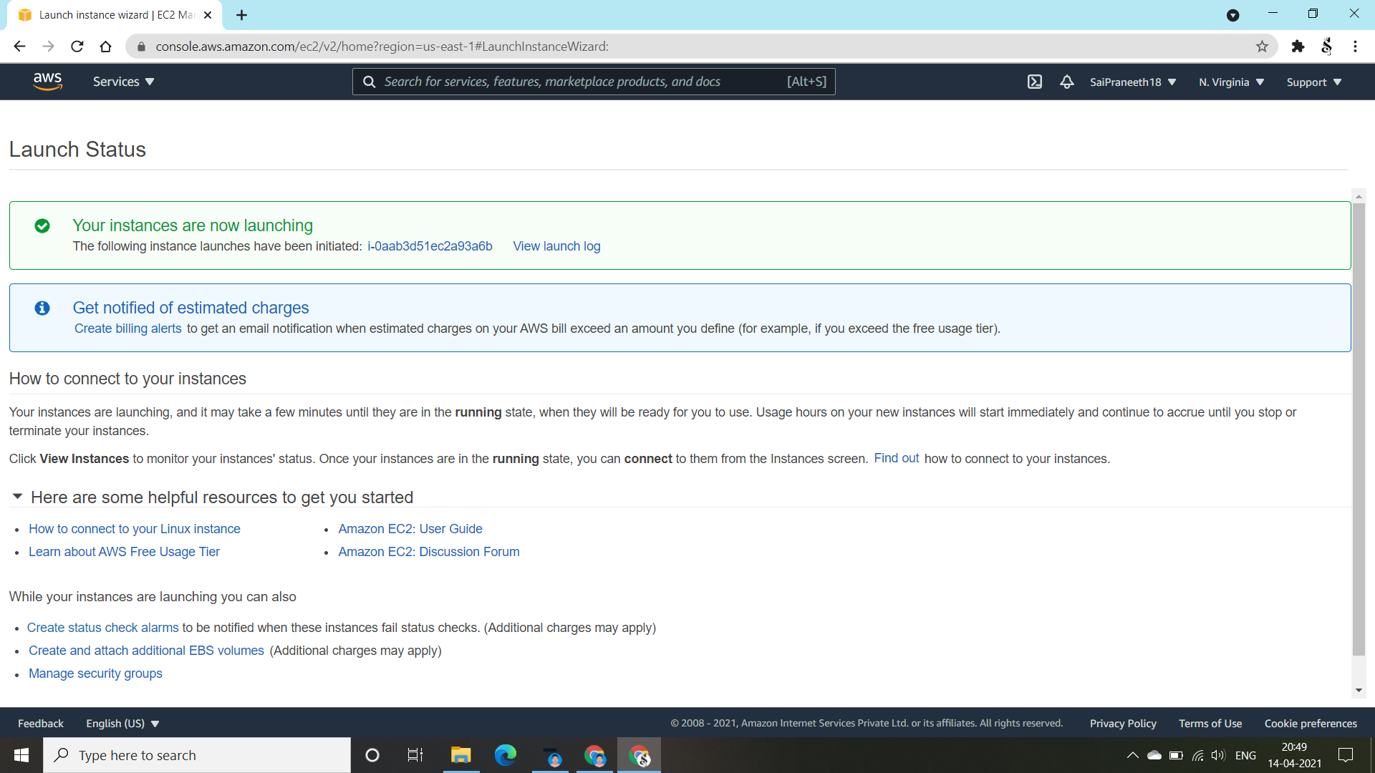
Now everything we need to do with the s3 bucket is almost done. Go to EC2 Management Console and launch an instance by making sure all the settings by default and also the security check add the HTTP & HTTPS. Review and launch the instance using an exsisting keypair or create a keypair. Here I’ve created a keypair named “majorproject” and launched the instance. Wait till the instance gets launched. Therefore it shows the launch status as shown above like “ Your instances are now launching” and then go back to the EC2 Management Console and look at the instances.

Slide 5
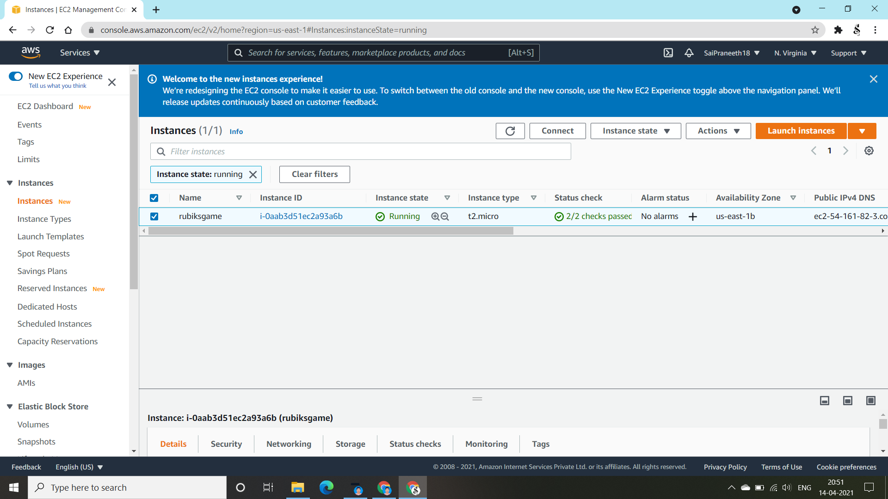
Now in the Instances page of the EC2 Management Console, we could see that the instance got launched I named it as “rubik’sgame”. Now we need to connect the instance to our console.

Slide 6
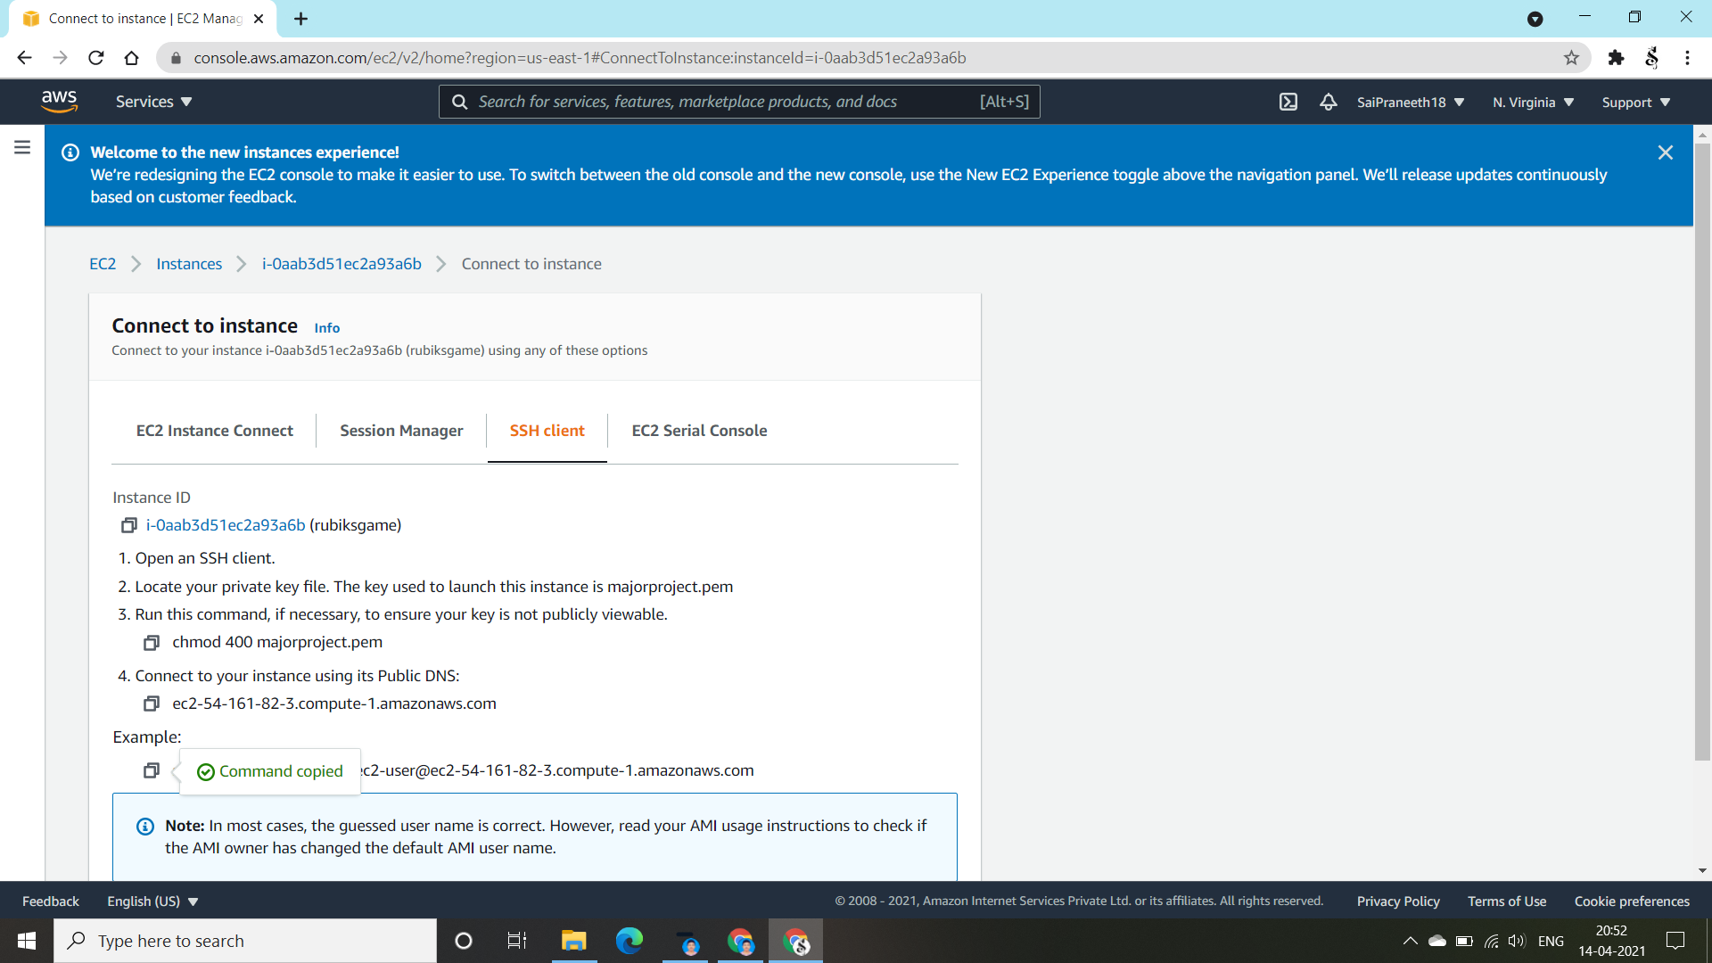
So, we are going to connect the instance with our console. Open the SSH Client copy the command of the user to paste it in the console.

Slide 7
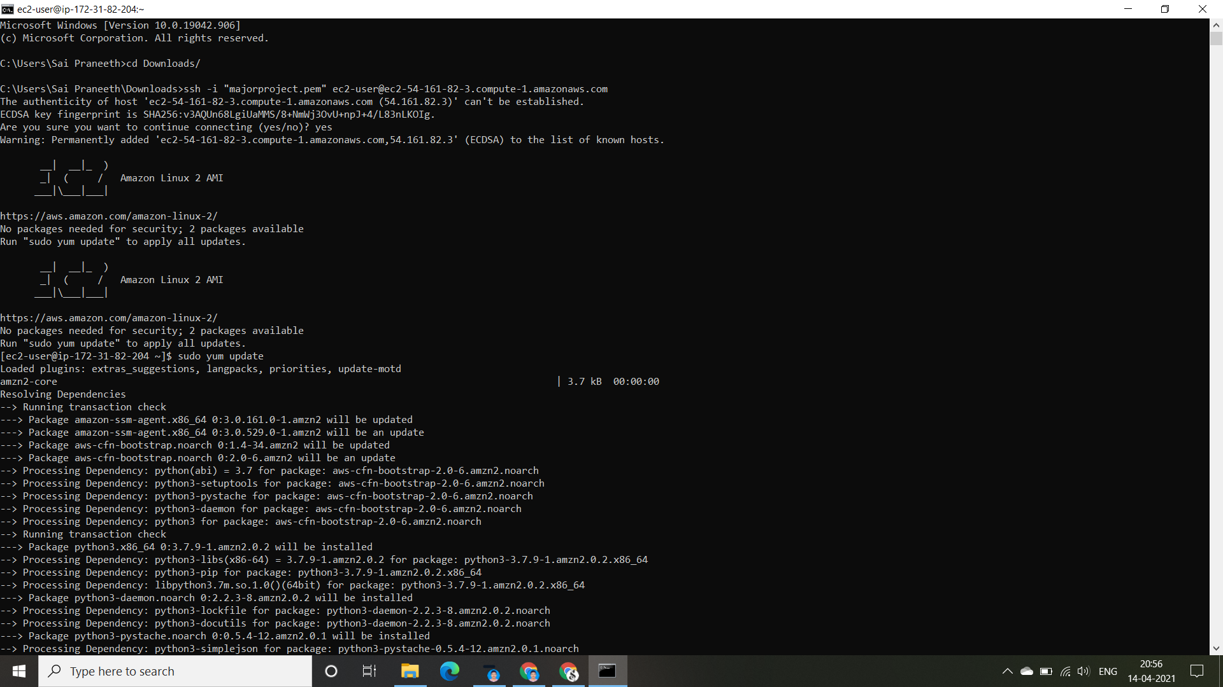
Now I’ve opened the console and changed my directory to Downloads by using the command “ cd Downloads/” and then I’ve pasted the command of the aws user and ran it. Therefore I got connected into the “Amazon Linux 2 AMI” cloud as shown in the above.

Slide 8
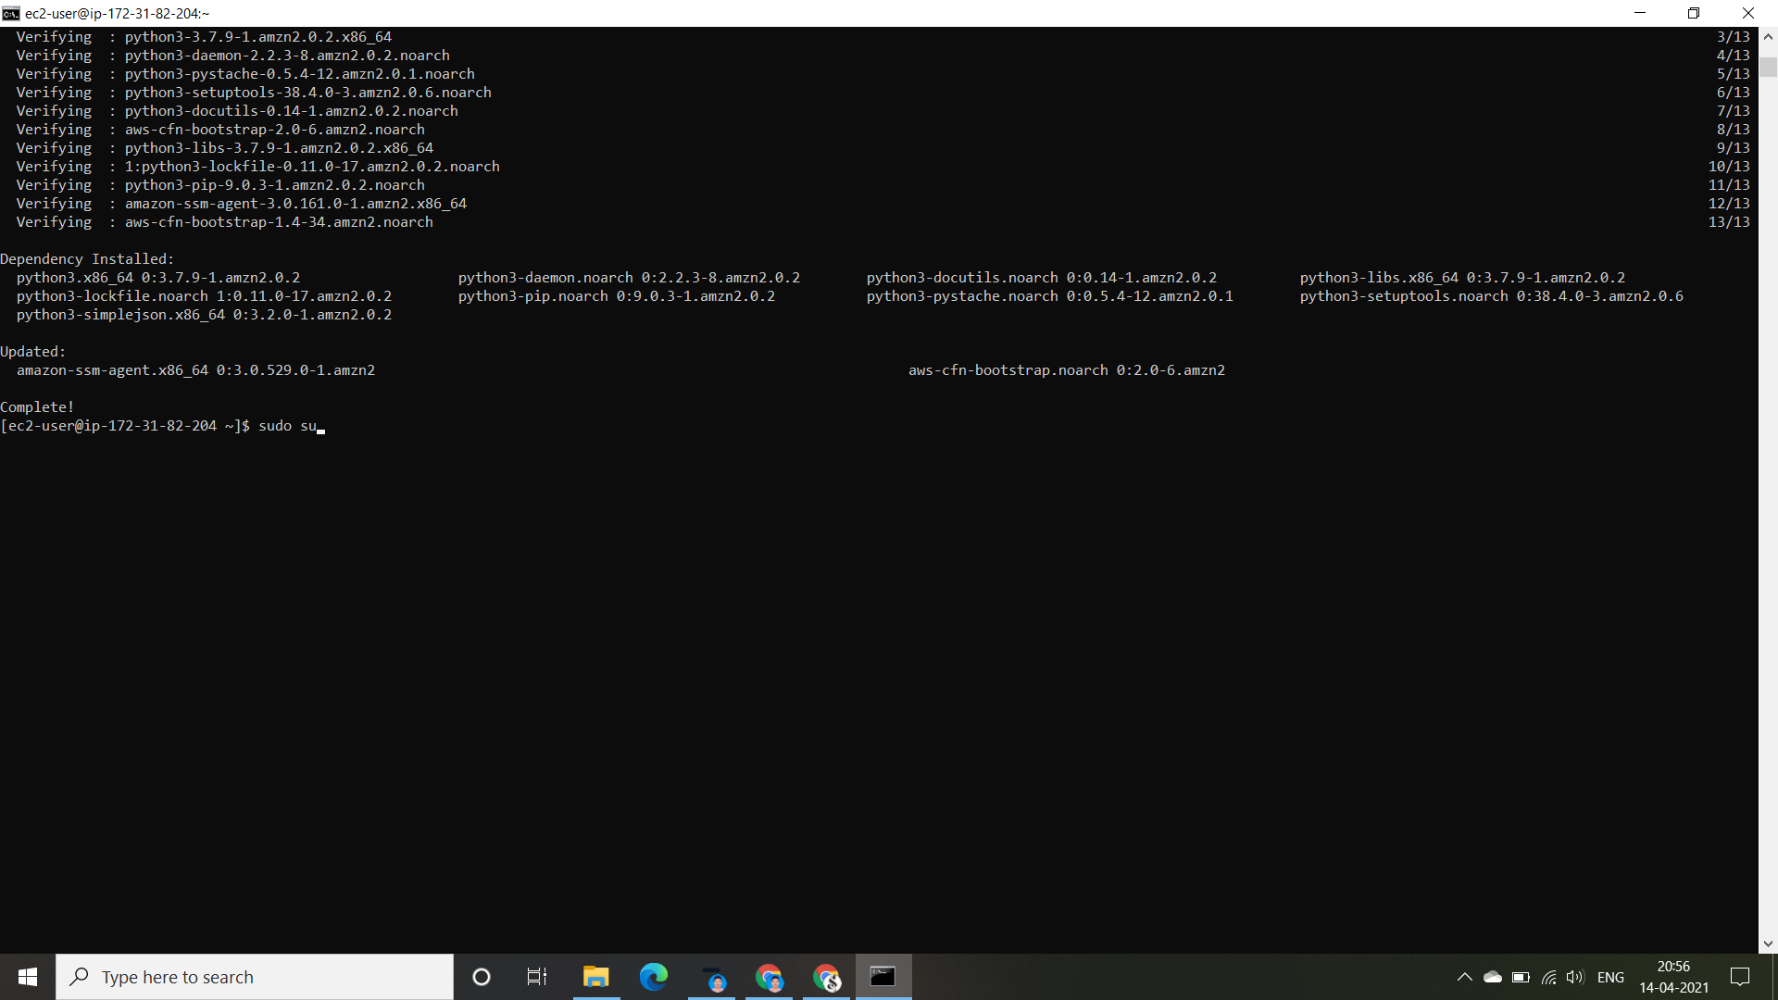
After entering into the amazon cloud, we need to get into our root user portal by using the command “ sudo su ”

Slide 9

After entering into our root user portal, Now we need to install our web launcher for our Rubik’s Cube gaming website. We do install it by using the command “ yum install httpd –y “. By clicking the “ENTER” , we could see the installation of our “APACHE” web launcher.

Slide 10
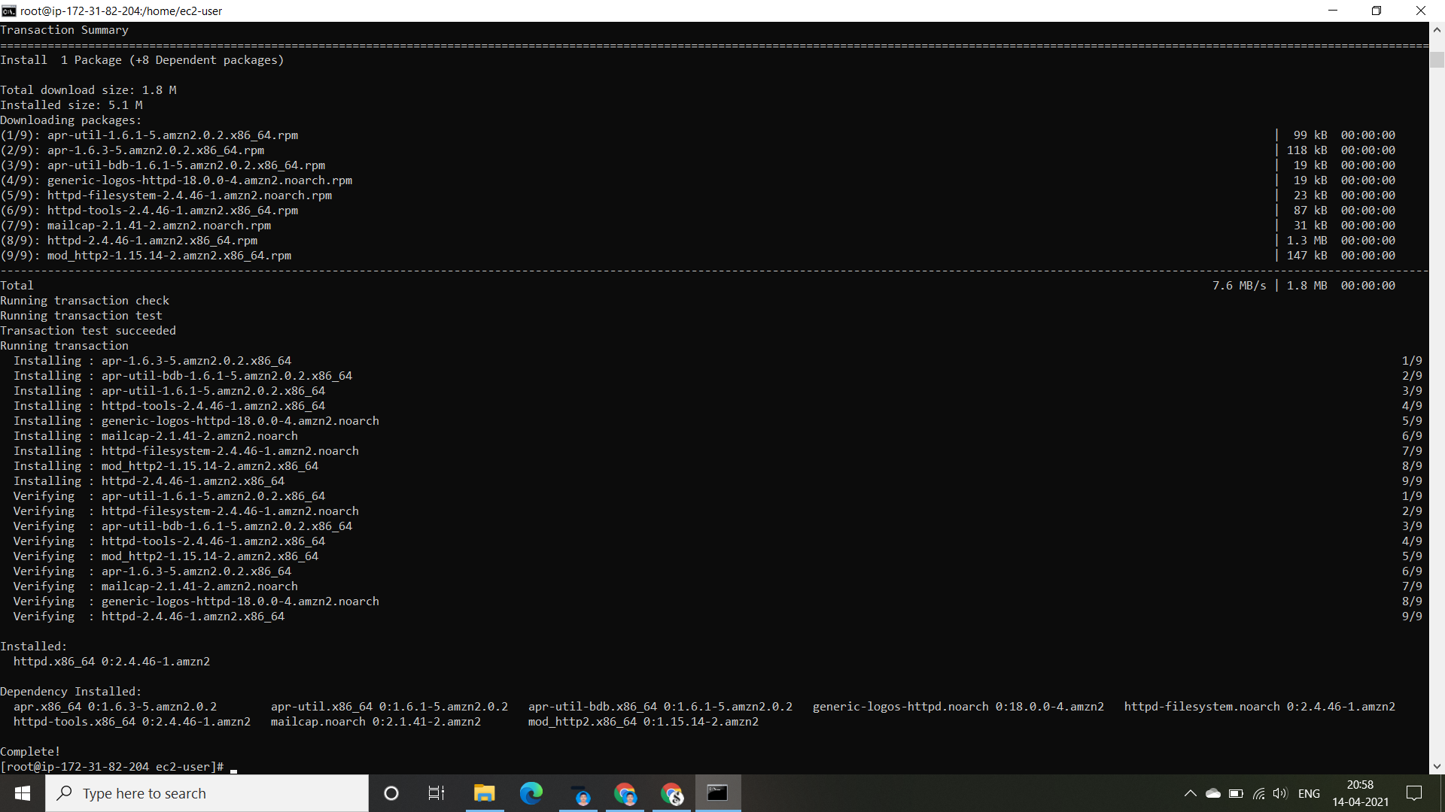
Here we could see the completion of installation of our web launcher “APACHE”. We should always remember one thing that a web launcher details should always in the directory having address “ /var/www/html”. So, we need to check whether our web launcher is in the desired directory or not. For that we use the command “pwd” which means present working directory.

Slide 11

So , by running the command “pwd” we came to know that the web launcher is the directory addressed “/home/ec2-user”. To make it to move to the desired directory we run the command “cd /var/www/html”. Then we again check the directory in which our web launcher is present by using the previous command. We got into the desired directory. Now we need to get the cube.zip data into this desired directory by the following procedure.

Slide 12
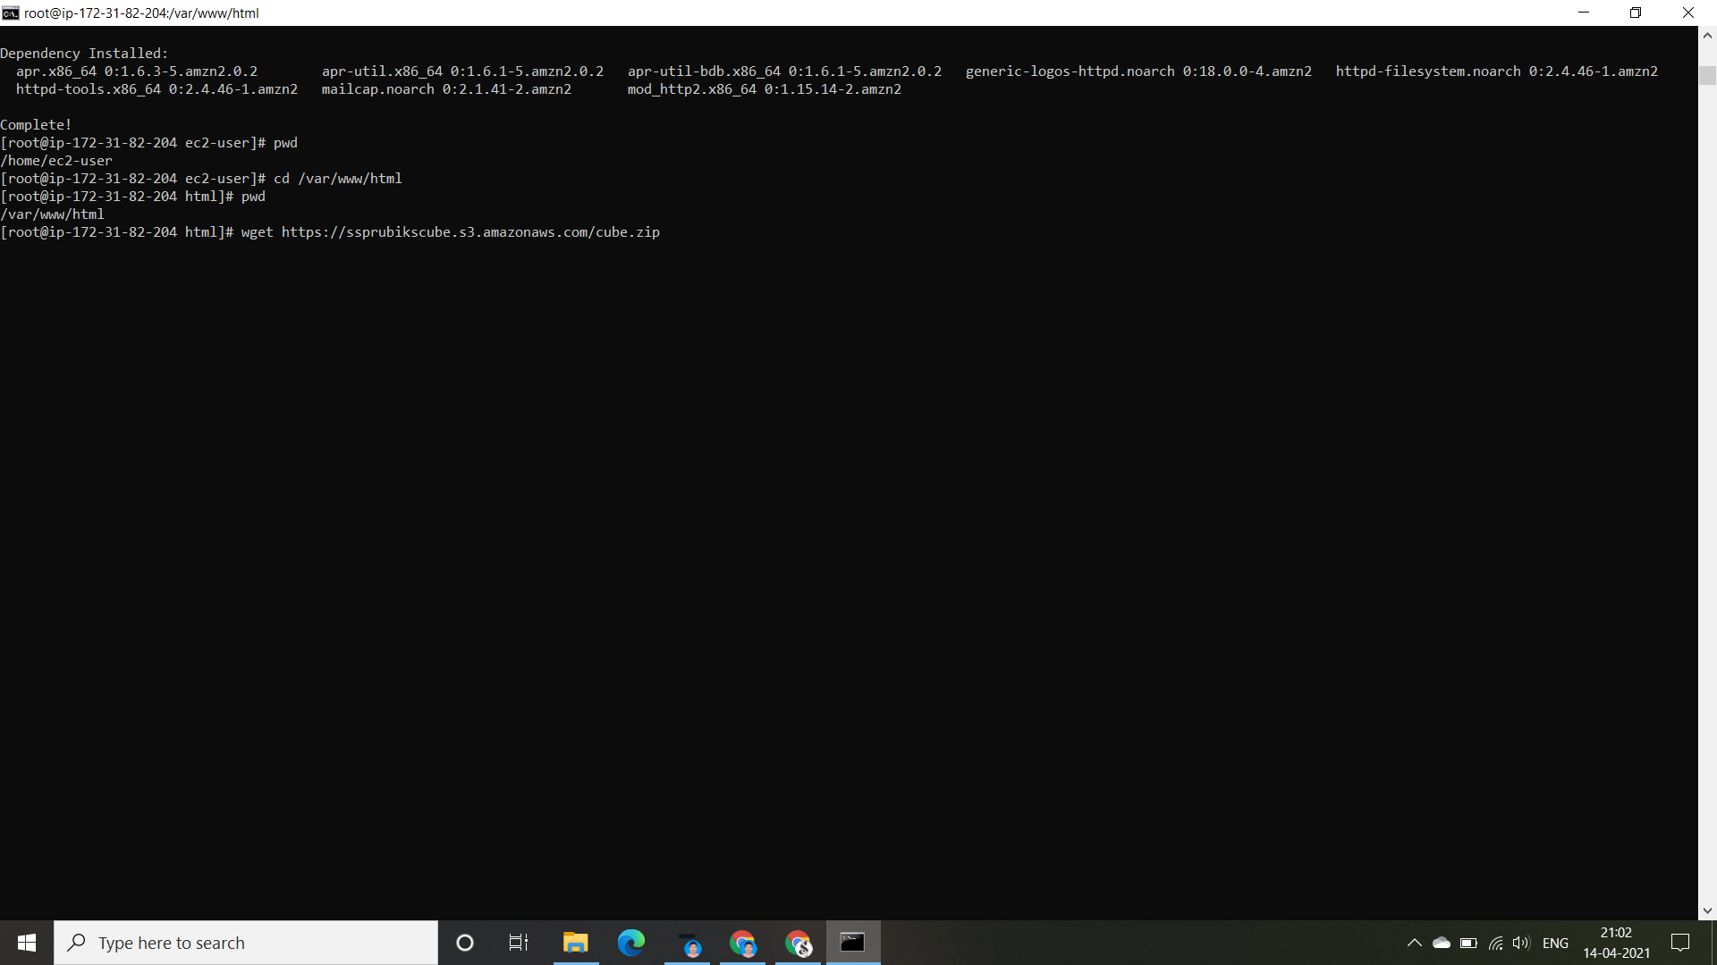
So, we need to download the cube.zip file into this desired directory. First we go the s3 Management Console and open our bucket and in the objects portal we find the cube.zip file . By opening it we would find a command/directory address of that file and we just copy it from there to paste it & run in the console. Now in the console we run the command “wget (ctrl+v)“ [ that we’ve copied in the s3 bucket] so that we could get the cube.zip file into the desired directory.

Slide 13

By running the command, we could get the “cube.zip” file into the desired directory. Now to check whether it came into it or not, we run the command “ls”

Slide 14

So, we can see that it got into the desired directory. Now we need to unzip the file using the command “ unzip cube.zip”. Then we could get the file contents into the desired directory.

Slide 15
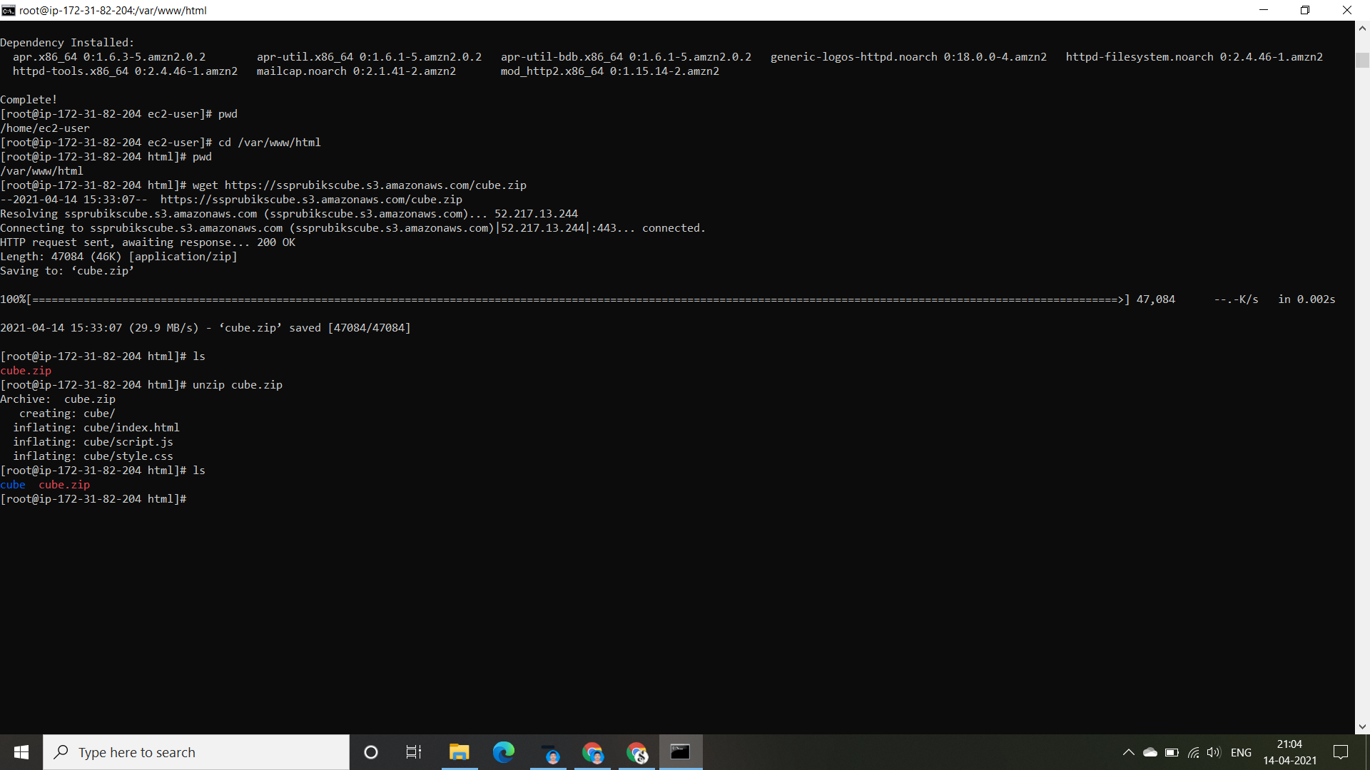
So by unzipping the cube.zip file, we got the cube folder now. By running the command “ls” we could check whether it came into it or not. Later by running the command “pwd” we can check where it is.

Slide 16
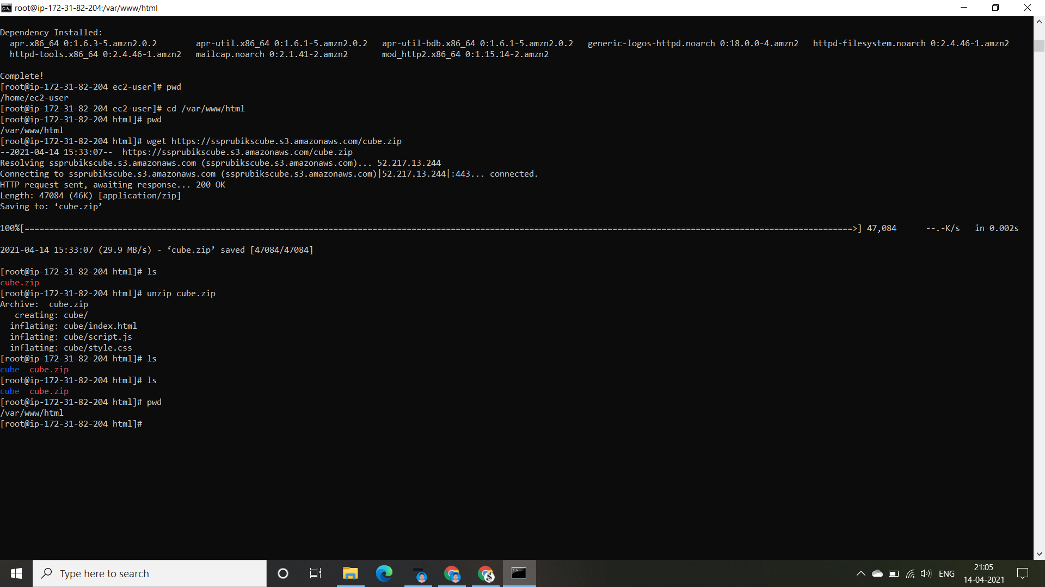
Now, we need to see the files that are present in cube folder. We go back to cube directory by using the command “ cd cube “, and then “ls” .

Slide 17
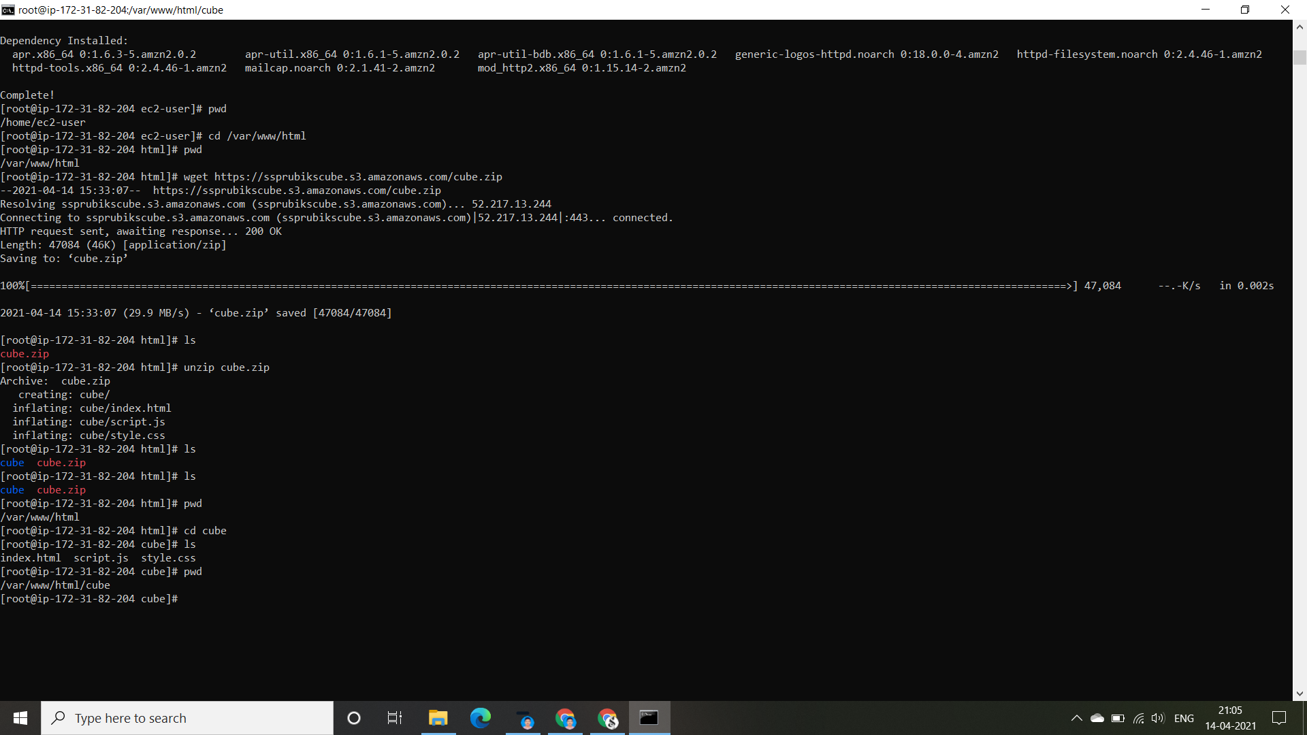
Therefore, we could see an html file named “index.html”, java script file named “script.js” and a css file named “style.css”. Now we’ve checked them where they are present using the command “pwd”. They are in directory addressed “ /var/www/html/cube”. We’ve previously said that the web launcher and the files and folder related to the website should be in the desired directory addressed “ /var/www/html”. So, we need to move/copy those files and folders into the desired directory .

Slide 18

Now we will copy the files that are present in the cube file and move them into the desired directory using the command “ cs index.html script.js style.css ../.” and then “cd ..” which moves them into the directory which is one before it. Now we run the command “pwd” to check whether they got moved desired directory or not. Therefore, they got into the desired directory.

Slide 19

By running the command “ls” we would come to know the files which are present in the desired directory.

Slide 20
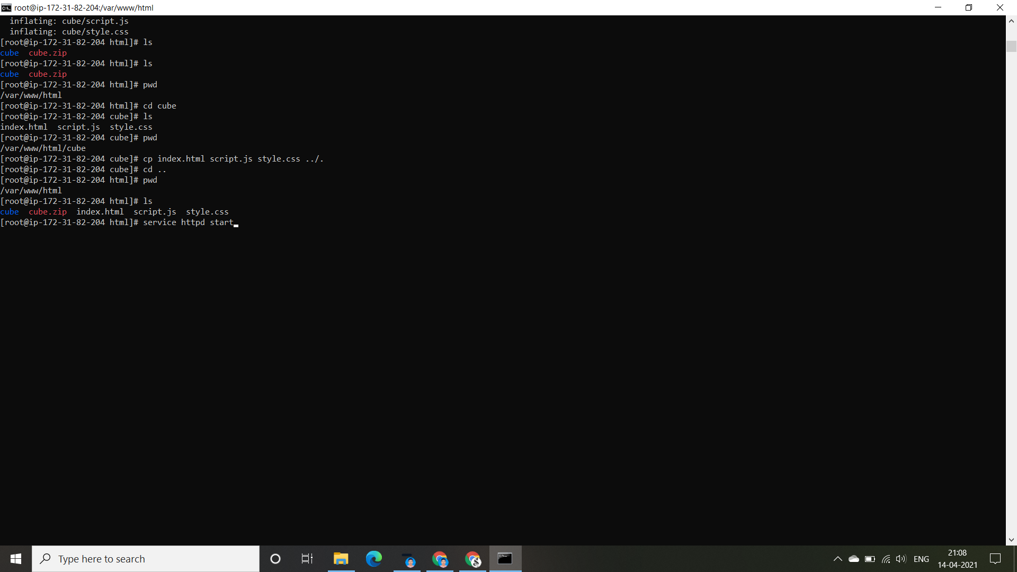
After getting all the required files into the desired directory, we need to launch the web launcher “APACHE” using the command “ service httpd start”

Slide 21

By running the command, we could see that the web launcher is getting launched. Now we need to go back to the EC2 Management Console and then into the instances and copy the IP address of the instance.

Slide 22
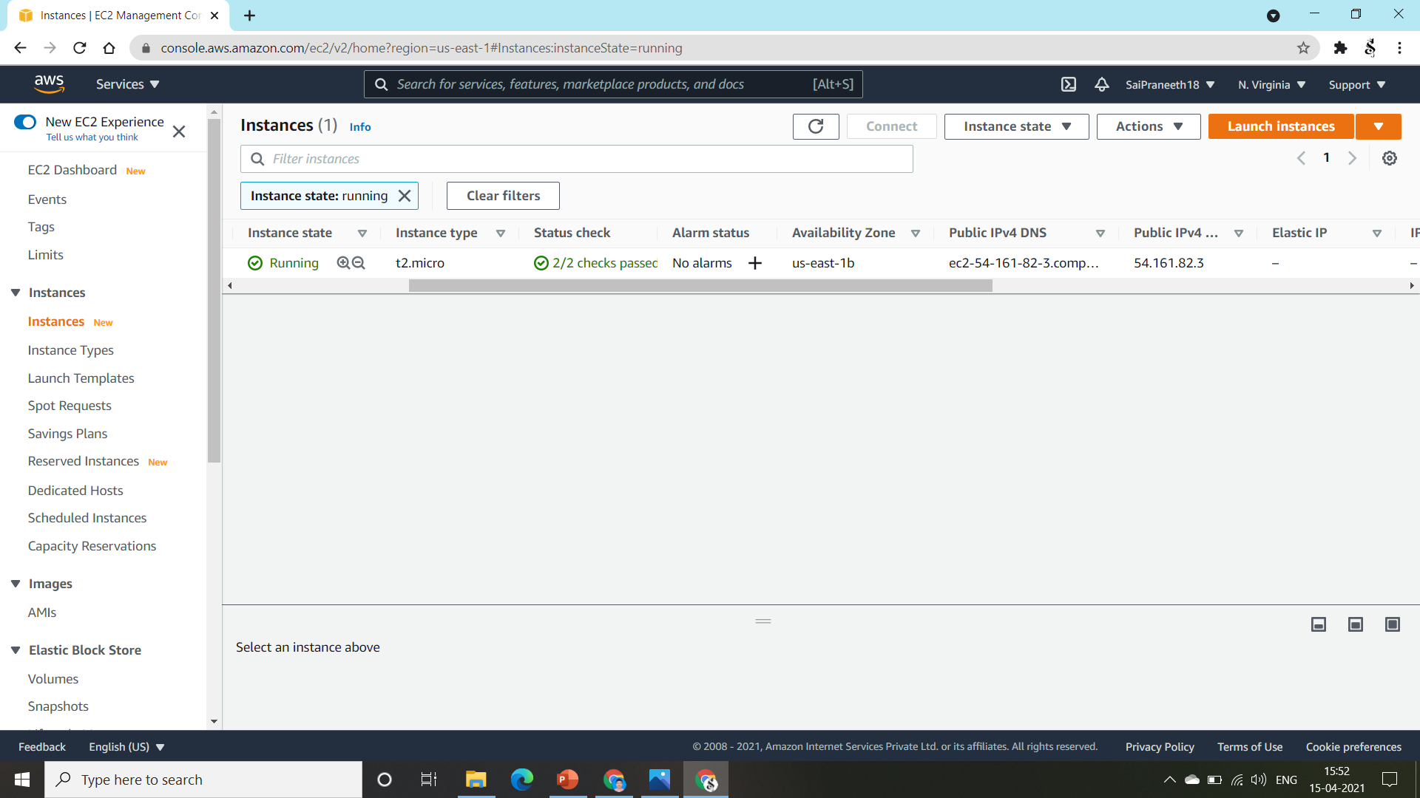
Now, we are going to copy the Public Ipv4… address and run it under the browser of the EC2 instance.

Slide 23
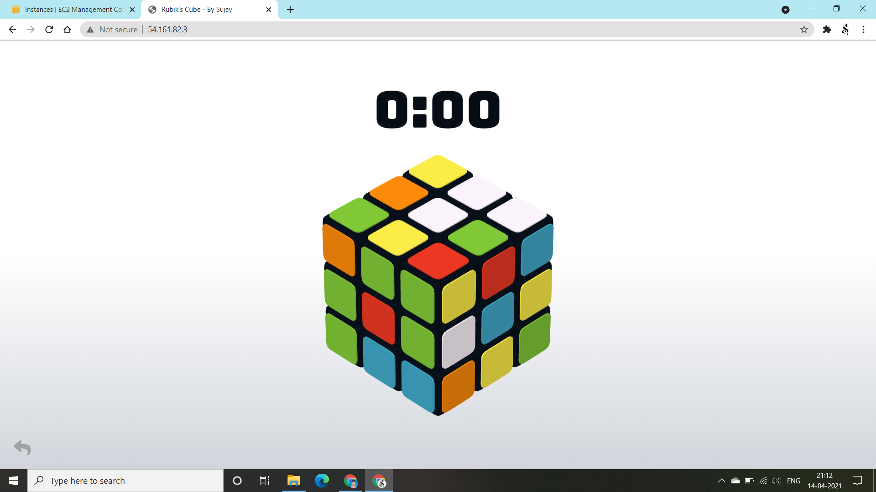
Now we got our Rubik’s Cube gaming website. By tapping the screen twice the timer could start and cube gets jumbled so that we can play. As I made it to public access , I would check it in the other devices too.

Slide 24
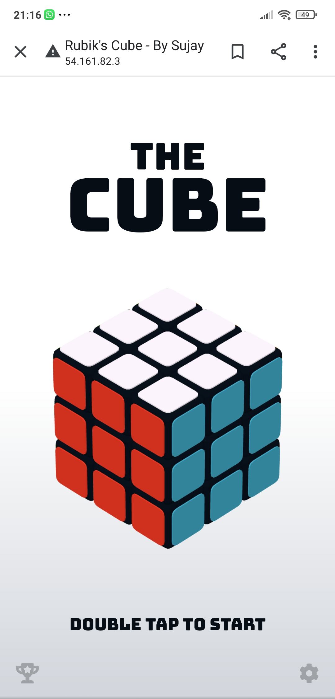
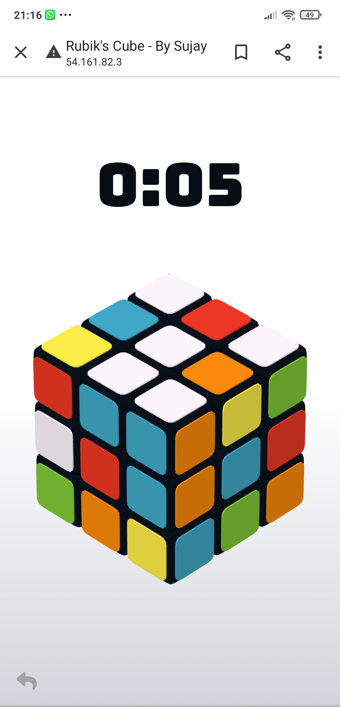
So, I got them running in my phone too. Therefore, I confirm that it is accessed to public. Hurray! We’re done with our Rubik’s Cube Gaming Website.

Slide 25
SOMISETTY SAI PRANEETH
My IP Address of Rubik’s Cube Game is 54.161.82.3

